Slide 1
Programming as a hobby.
This project work is made by the students
Dmitriev Vladimir
Hakimov Ilnaz
Ildukov Maksim

Slide 2
Programming for everyone
Nowadays in the age of computer technologies no one can go without computers , so in this work we would like to show you how to turn a meaningless seat at the computer in useful work that could turn into a profession in the future.

Slide 3
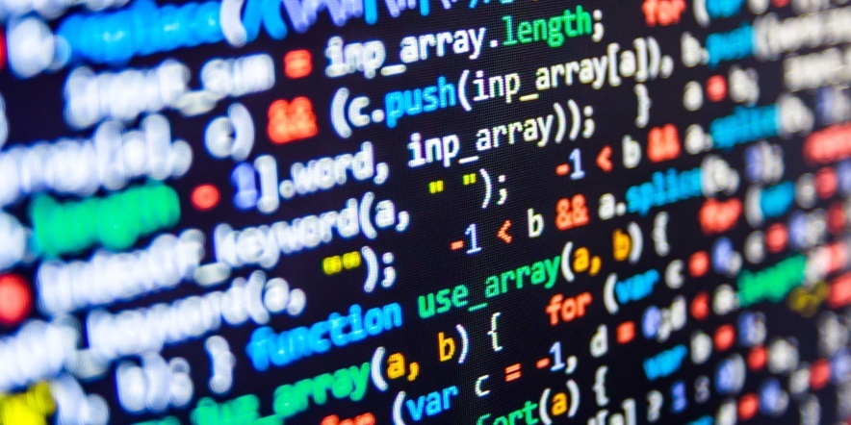
Programming for me.
For us programming is fun, so we want to turn it into a profession and to connect our lives with IT.

Slide 4
Than useful programming.
Programming develops diligence and unconventional way of thinking.
Learning to program, a person can become very useful to the public. He can create a program to help disabled, elderly, to develop a robotic assistant, and a lot of other useful things.

Slide 5

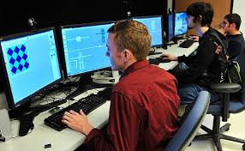
Work as a programmer.
Waiting
Reality

Slide 6
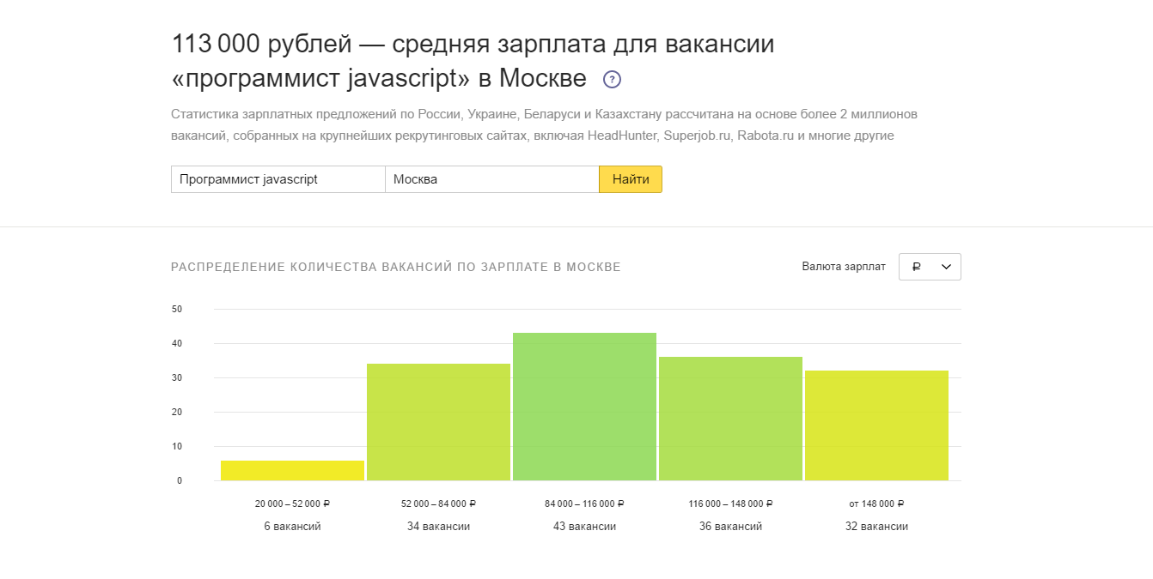
Many people think that the work of a programmer is complicated and not profitable, but in reality it is not so. With proper training, developing applications and creating websites you can earn good money.

Slide 7
As it seen in the picture, the average wage of a programmer is 113000 roubles, the salary of a programmer of average level. The beginner programmer can work as a freelancer and work remotely via the Internet. There are many sites where you can find employers.

Slide 8
Where can you learn programming?
Unfortunately in Leninogorsk there are no specific institutions where you can teach programming, but you can always find suitable courses on the Internet. There is a great variety of them: from free online tutorial, built step-by-step games to pay online seminars for the passage where you can get a diploma certifying your education.

Slide 9
We would like to recommend you a couple of sites on which we are being taught ourseives.
Http://javarush.ru
https://geekbrains.ru
http://skill-box.ru/coder

Slide 10
Thank you for your attention!

